Slide 1
Career Services Overview Jonathan Medina

Slide 2
The Joys of JavaScript
Day 7
July 7th, 2016

Slide 3
Homework #2 – Questions?
Two parts to the assignment
Take existing Portfolio and apply Media Queries and Viewport to make mobile responsive.
Find a Bootstrap theme you like and apply the Bootstrap theme to your website.

Slide 4
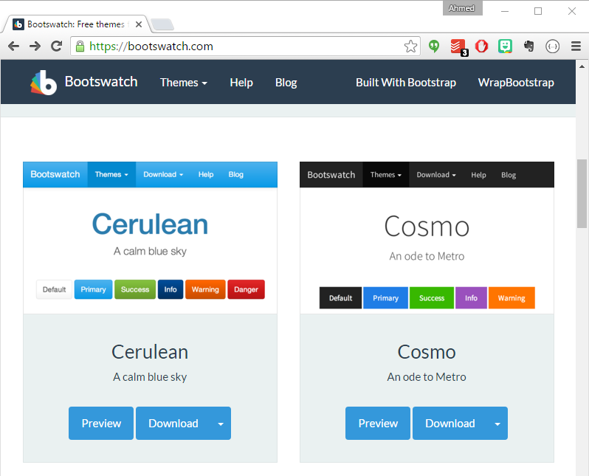
Bootswatch Styling
https://bootswatch.com/

Slide 5
Demo Time
Instructor: Demo
(layout.html | 0-Bootswatch)

Slide 6
Today’s Class! {oh, and Slack Question ROE}

Slide 7
Objectives
In today’s class we’ll be introducing:
Javascript Definitions
Javascript Basics:
Variables
Logging, Alerting, Prompting
Arrays
If-Then Statements

Slide 8
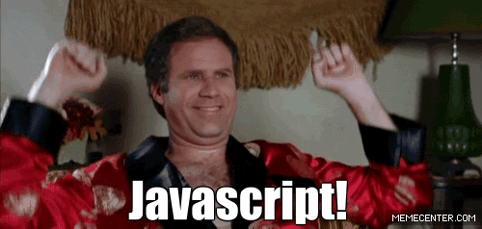
OMG Javascript!
Prepare to become true coders.

Slide 9
How to Learn Javascript

Slide 10
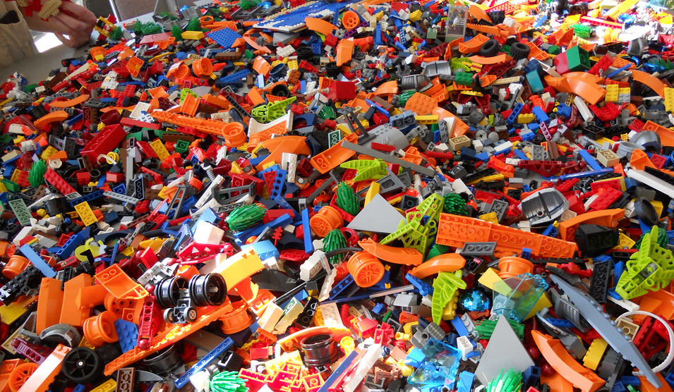
Your Brain on Javascript… {How does it all fit together?}

Slide 11
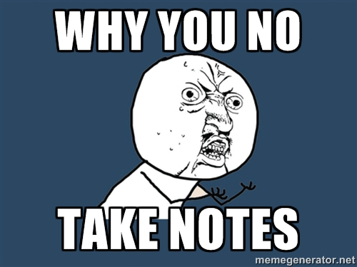
Time to Take Notes…

Slide 12
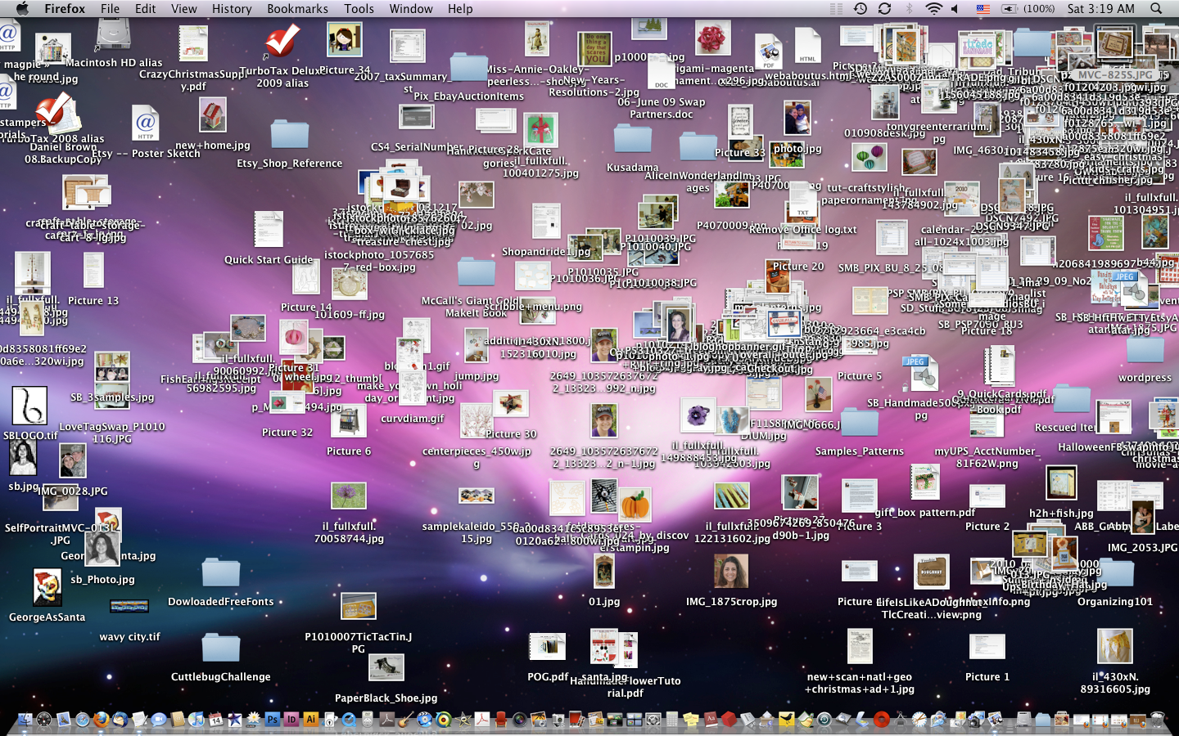
And Keep Organized!!! {Folder/Directory Structure is critical to ‘not wasting time’}

Slide 13
Overall Tips
Review Immediately: We’ll be building upon these concepts quickly. The firmer your grasp now, the better off you’ll be.
Re-do the exercises from class: Don’t just re-read! Actually spend the time to do them from scratch.
Get Help: Come to office hours. Ask conceptual questions. Ask specific questions. Just keep asking questions! Google Hangout on Friday…
Don’t be Afraid: You will get this. It will take time, but you will get this. Just keep at it. Patience will pay off.

Slide 14
Warmup Activity

Slide 15
> YOUR TURN!!
Code Dissection:
Pull the file `JSDissect.html` from class github repo 0620-mw-class-content/weekday-activities folder.
Open it in Chrome and watch what happens.
Open the file in Sublime explain to someone around you how the code connects to the events seen on the page.
p.s. I know we haven’t covered Javascript before…

Slide 16
What is Javascript?

Slide 17

Javascript Definitions
Javascript is the third of the three fundamental programming languages of the modern web (along with HTML, CSS)
Javascript allows developers to create dynamic web applications capable of taking in user inputs, changing what’s displayed to users, animating elements, and much more.

Slide 18
Variables

Slide 19
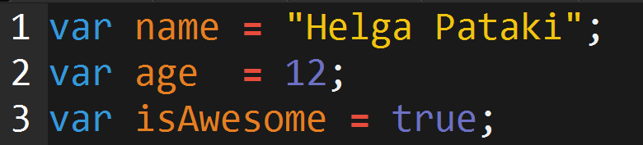
Basic Variables
Variables are the nouns of programming.
They are “things” (Numbers, Strings, Booleans, etc.)
They are composed of variable names and values

Slide 20
INSTRUCTOR DEMO!
Variable Assignment

Slide 21
Demo Time
Instructor: Demo
(BasicVariablesDemo | 02-BasicVariablesDemo)
// Variables can be strings, numbers, or booleans (true / false)
Example of assigning one of each to a variable
var {name} = {value};
Strings have quotes!

Slide 22
Basic Variables (Syntax)
Var Keyword
Variable name
Assignment
Value
Termination
var
name
=
“Helga”
;

Slide 23
Basic Variables (Syntax)
Var Keyword
Variable name
Assignment
Value
Termination
var
name
=
“Helga”
;
Be sure to notice the quotes (“”),
which convey that Helga is a string

Slide 24
> YOUR TURN!!
Code Creation:
Using the instructions in the file sent to you, fill in the missing Javascript code to create variables.
When done, open the file in Chrome and check the output.
If you completed the activity correctly, you should see a series of pop-up windows with text inside.
Then look at the rest of the code to understand why the text displayed the way it did.

Slide 25
Logs, Prints, Alerts

Slide 26
Demo Time
Instructor: Demo
(ConsoleDemoInstructor.html | 04-ConsoleLogDemo)
Where is it in Chrome?
Displays text, variables, combinations and much more…

Slide 27
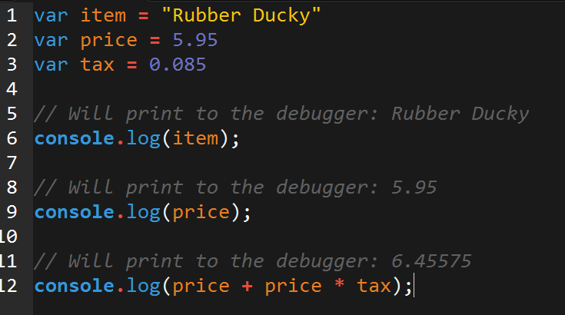
Console.log
console.log is a quick expression used to print content to the debugger.
It is a very useful tool to use during development and debugging.

Slide 28
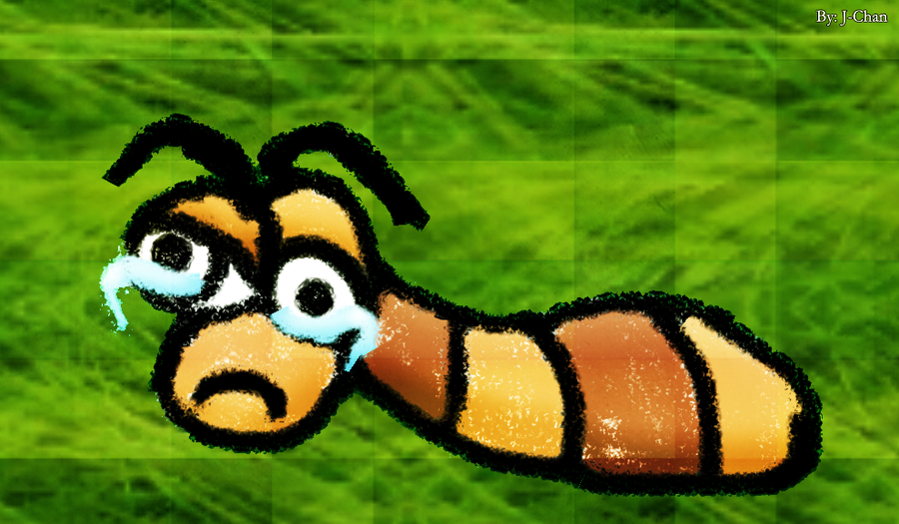
Sad Little Bug…
Hey Class!
How do you comfort a Javascript bug?

Slide 29

Sad Little Bug…
Hey Class!
How do you comfort a Javascript bug?
You “console” it.

Slide 30
Sad Little Bug…
Don’t worry!
It was a hilarious joke… that will make sense in a few weeks.

Slide 31
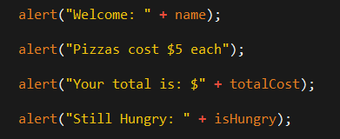
> YOUR TURN!!
Code Creation:
Take your previous code from the pizza example, then replace all of the alert messages with console.log.
Then open the file in the browser and open up chrome Developer tools -> Console to confirm the changes worked.
Talk to those closest to you about the difference between alert and console.log

Slide 32
Break – back at 8:00pm

Slide 33
INSTRUCTOR DEMO!
Alerts, Prompts, Confirms

Slide 34
Demo Time
Instructor: Demo
(PromptDemo.html | 06-PromptDemo)

Slide 35
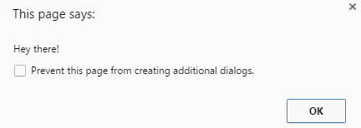
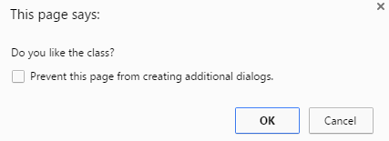
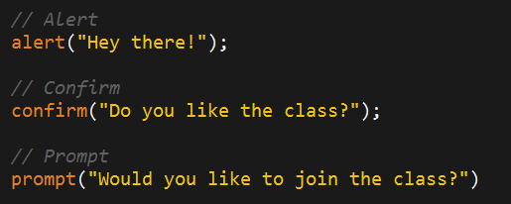
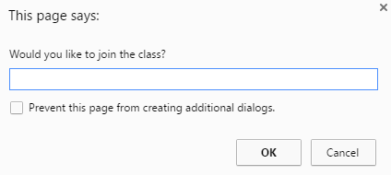
Alerts, Prompts, Confirms
Alerts, Confirms, and Prompts will create a popup box in the browser when run.
These are also useful for development and debugging.

Slide 36
> YOUR TURN!!
Code Creation:
Create code using Javascript that does all of the following:
Asks the user with a confirm: “Do you like _____” and store it into a variable.
Ask the user “What kind of ________” do you like with a prompt and store that into a variable.
Alert both variables to the screen.

Slide 37
Document Write

Slide 38
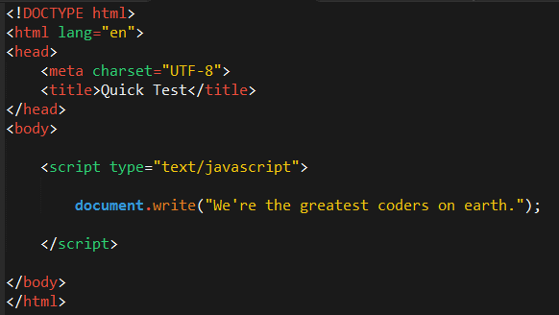
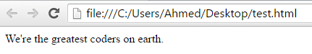
Writing to HTML
We can also use Javascript to directly write to the HTML page itself using document.write( ).
Later we will go over much more advanced approaches for writing HTML using Javascript and jQuery.
Test.html (chrome)
Test.html (sublime)

Slide 39
If-Then Statements

Slide 40
Demo Time
Instructor: Demo
(conditionaldemo.html | 08-ConditionalDemo)

Slide 41
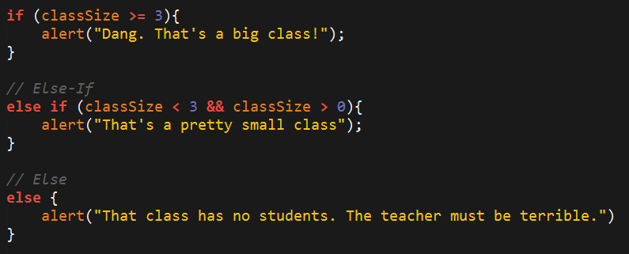
If-Then Statements
If-Then statements are critical.
Each statement is composed of an if, else-if, or else (keyword), a condition, and the resulting code in { } curly brackets.

Slide 42
> YOUR TURN!!
Code Creation:
Create a website that asks users if they eat steak.
If they do then write the following to the screen: “Here’s a Steak Sandwich”
If they don’t then write the following to the screen: “Here’s a tofu stir fry”
Bonus: Ask what the user’s birth year is. If they are under 21, post: “No Sake for you!”
Hint: You will need to use document.write( ) from the last activity

Slide 43
> YOUR TURN!!
Code Dissection:
Open the file sent to you in Sublime.
Then with a partner, go through and predict what the result of each “conditional” statement will be (i.e. will the “if” or the “else” be triggered).
Then run the program to check if you are right. Note any that you got wrong and ask about it in class.

Slide 44
Arrays

Slide 45
The Zoo Pen
Array Name: zooAnimals
Zebra
Rhino
Giraffe
Owl
Index 0
Index 1
Index 2
Index 3

Slide 46
The Zoo Pen… Coded
Array Name: zooAnimals
Zebra
Rhino
Giraffe
Owl
Index 0
Index 1
Index 2
Index 3
Coded in Javascript using an Array

Slide 47
INSTRUCTOR DEMO!
Arrays

Slide 48
Demo Time
Instructor: Demo
(ArraysDemo.html | 11-ArraysDemo)

Slide 49
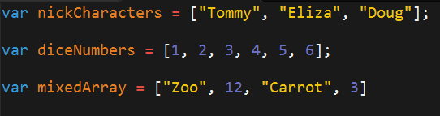
Basic Arrays
Arrays a type of variable that are collections.
These collections can be made up of strings, numbers, Booleans, other arrays, objects, anything.
Each element of the array is marked by an index. Indexes always start with 0.

Slide 50
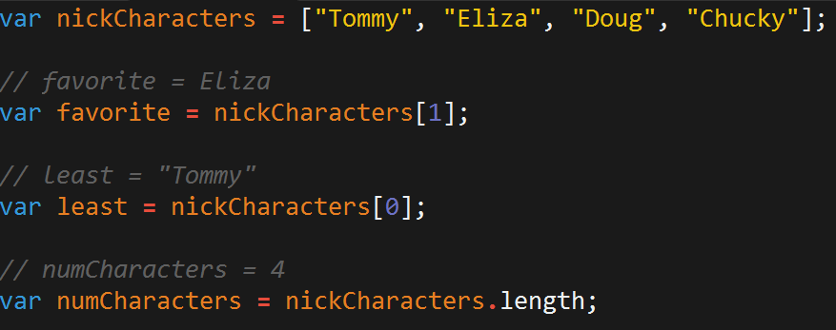
Basic Arrays Indices
To recover the value at any specific index you include the name of the array with a square bracket [ ] and inside the bracket is the element’s index.
You can easily grab the number of elements in the array using the method array.length.

Slide 51
> YOUR TURN!!
Class Code Dissection:
Take a few moments to look over the following file with a partner.
Then create a comment line above each console.log() line to “predict” what the output will be.

Slide 52
Homework #3

Slide 53
Questions?

Slide 54
Homework #2 Questions

Slide 55
Challenge Activity?

Slide 56
> YOUR TURN!!
Code Creation (Challenge):
Create a website that checks if users favorite band is one of your favorite bands.
If it is one of your favorite bands, then create an alert saying: “YEAH I LOVE THEM”.
If it’s not create an alert saying: “Nah. They’re pretty lame”
Hint: You will need to research how to use .indexOf()
Hint: You will need to research how to use .toLowerCase()

Slide 57
> YOUR TURN!!
Code Dissection (Re-examined, Time-permitting):
Re-examine the file sent to you at the start of class.
See if you can better understand how it works – after having gone through today’s class.

